Slide 1
Concurrent and Parallel Systems Condition variables
Dr Sergio Davies <sergio.davies@shu.ac.uk>
Department of computing
Sheffield Hallam University
17 October 2022
Notes:
Hello and welcome back!
Today we are going to cover condition variables

Slide 2
TUTORIAL: Locking multiple resources Dining philosophers problem
Notes:
Today’s tutorial session will cover the dining philosophers problems

Slide 3
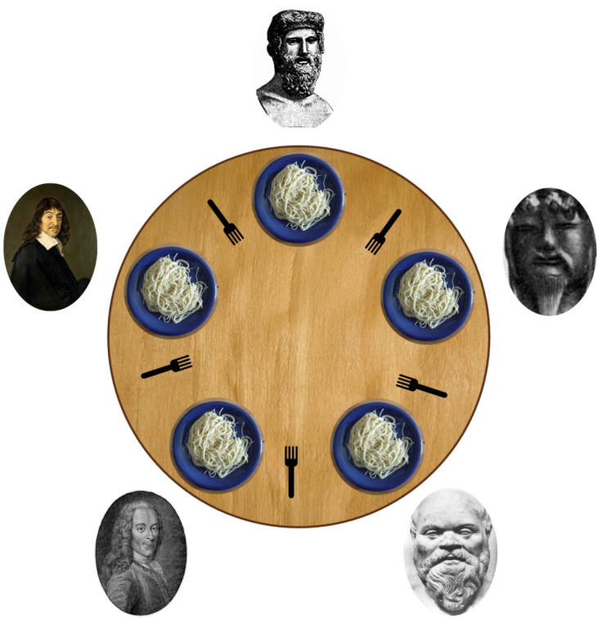
Example – Dining philosophers
Silent (no interactions with other diners)
Either thinks or eats
Can only eat spaghetti when they have any two forks
Each fork can be held by only one philosopher.
After an individual philosopher finishes eating, they need to put down both forks so that the forks become available to others.
A philosopher cannot start eating before getting both forks.
Eating is not limited by the remaining amounts of spaghetti or stomach space; an infinite supply and an infinite demand are assumed.
Notes:
Let’s analyse this situation: there are five philosophers around a table, ready to have dinner. There are 5 dishes with an infinite amount of food in them, and 5 forks.
All philosophers are deep in their thoughts and don’t communicate. Every now and then they need to eat. So thinking and eating are the only two operations that each philosophers can perform.
Each philosophers requires two forks to eat, and a fork can only be held by one philosopher.
When a philosopher obtains both forks, eats some food and then releases both forks.

Slide 4
Example – Dining philosophers
How to design a concurrent algorithm such that each philosopher won’t starve, i.e. he can forever continue to alternate between eating and thinking, assuming that any philosopher cannot know when others may want to eat or think.
This problem was designed to illustrate the challenges to avoid starvation and/or deadlocks
Possible solutions:
Mutual exclusion: when a philosopher eats, others don’t try to;
Order in which forks are taken;
Arbitrator (e.g. waiter)
...
Notes:
How can we design an algorithm such that each philosopher won’t starve? This means that each philosopher can alternate between eating and thinking assuming that any other philosopher cannot know when others may want to eat or think.
His is a classical problem that illustrates the problem related to deadlocks and starvation and the use of multiple resources.
There are many possible solutions and implementations

Slide 5
Example – Dining philosophers
Example
Source code provided by: https://mariusbancila.ro/blog/2017/01/16/dining-philosophers-in-cpp11/
Notes:
There is one implementation in C++, which we will use as basis for this tutorial.

Slide 6
Tutorial session
A solution to the dining philosopher problem is provided on the website. The “magic” happens in the function “void eat()”. The first instruction of the function locks two semaphores avoiding deadlocks automatically (C++11 feature): std::lock(left_fork.mutex, right_fork.mutex);
Your task is to replace this constructor, by locking directly the mutex variables provided, avoiding deadlocks!
Notes:
The implementation is working correctly, but uses some “magic”: in the function “eat” the first instruction locks two forks. C++ takes care automatically of the problem of locking multiple resources avoiding deadlocks.
However, your task is to replace that instruction with an algorithm that allows locking the two semaphores, but avoids deadlocks and starvation.
This is a task for the brain, rather than for the hands: it requires careful thoughts before you decide how to implement it.
Have fun!!!

